Slide 1
Interfacing Raspberry pi with Speaker
Presenter- Amonjot Singh Chhina
C0772326

Slide 2
Introduction
In this presentation we will interface a speaker with raspberry pi through AUX port available on raspberry pi. The audio signal will come from raspberry pi and the speaker is powered through a micro usb.After this presentation we will gain knowledge about how to control and use speaker through raspberry pi

Slide 3
Smart greenify project
Project Concept: Smart Greenify is a device that helps indoor plants to survive without much effort from the owner. The device has sensors to detect the water level, humidity, and temperature, and all these parameters can be controlled by the particular plant’s requirement. Grow lights will be used to give artificial sunlight to the plants. Speaker will be used for music. All the data and controls can be accessed on a handheld device wirelessly over Bluetooth. We also will have a camera to monitor the Plant’s health.

Slide 4
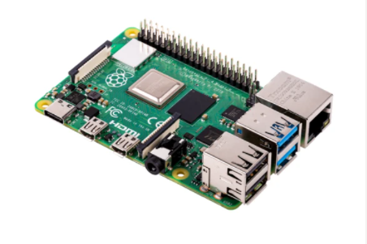
Raspberry pi 4
In Smart greenify project Raspberry pi 4 is used as main MCU and in order to interface a speaker, it can be done through wired connection as it has 2 HDMI ports that can be used as audio output and 1 AUX port as well and speaker can also be connected wirelessly through Bluetooth as Raspberry pi have BLE

Slide 5
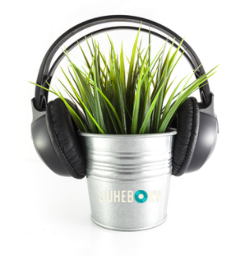
Case study regarding benefits of music to plants
In 1962, an Indian botanist conducted several experiments on music and plant growth. He found that certain plants grew an extra 20 percent in height when exposed to music, with a considerably greater growth in biomass. He found similar results for agricultural crops, such as peanuts, rice, and tobacco, when he played music through loudspeakers placed around the field

Slide 6
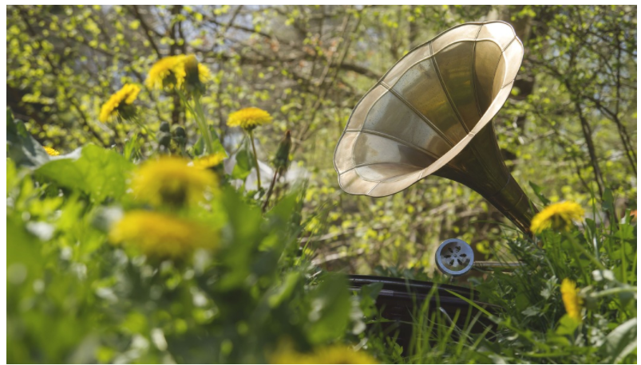
Benefits of music to plants
Sound waves stimulate the plant's cells. When the cells are stimulated by the sound, nutrients are encouraged to move throughout the plant body, promoting new growth and strengthening their immune systems.

Slide 7

Benefits of music to plants
Studies indicate that plants also seem have a specific taste in music. Some genres of music promote growth, whereas others can be damaging. Roses in particular seem to love violin music. For most plants playing classical or jazz music caused growth to increase, while harsher metal music induced stress. This may be because the vibrations of metal music are too intense for plants and stimulate cells a little too much.

Slide 8
Benefits of music to humans
It’s heart healthy: Research has shown that blood flows more easily when music is played. It can also reduce heart rate, lower blood pressure, decrease cortisol (stress hormone) levels and increase serotonin and endorphin levels in the blood.
It elevates mood: Music can boost the brain’s production of the hormone dopamine. This increased dopamine production helps relieve feelings of anxiety and depression.
It reduces stress: Research has found that listening to music can relieve stress by triggering biochemical stress reducers.

Slide 9
Benefits of music to humans
It relieves symptoms of depression: When you’re feeling down in the dumps, music can help pick you up - much like exercise.
It stimulates memories: There is no cure for Alzheimer’s disease or dementia but music therapy has been shown to relieve some of its symptoms. Music therapy can relax an agitated patient, improve the mood and open communication in patients.
It manages pain: By reducing stress levels and providing a strong competing stimulus to the pain signals that enter the brain, music therapy can assist in pain management.

Slide 10
Benefits of music to humans
It eases pain: Music can meaningfully reduce the perceived intensity of pain, especially in geriatric care, intensive care or palliative medicine.
It helps people eat less: Playing soft music in the background (and dimming the lights) during a meal can help people slow down while eating and ultimately consume less food in one sitting.
It increases workout endurance: Listening to those top workout tracks can boost physical performance and increase endurance during a tough exercise session.

Slide 11
Required Apparatus
Raspberry pi 4
Host machine
Active speaker with aux connection
Internet connection

Slide 12
Modes of Speaker Interface
HDMI
Bluetooth
AUX port

Slide 13
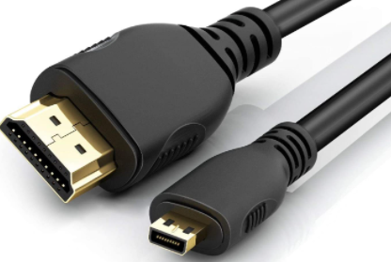
HDMI
HDMI ports 1 and 2 inside raspberry pi can be used as audio output.If your HDMI monitor or TV has built-in speakers, the audio can be played over the HDMI cable. HDMI can be selected as audio output by Right-clicking the volume icon on the desktop taskbar brings up the audio output selector; this allows you to select between the internal audio outputs or through terminal

Slide 14

BLUETOOTH
Raspberry pi 4 have in-build Bluetooth 5.0 and it can also be used to connect to a speaker and in order to connect to a speaker through bluetooth we can use pulseaudio tool which is required to be installed as it is not pre-installed inside raspberry pi 4.

Slide 15
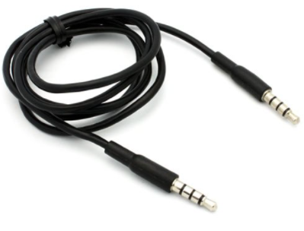
AUX port
An auxiliary port is available in raspberry pi4 which can be used for audio transmission.
In order to use speaker through AUX port we need to use an active speaker as output from AUX port is not enough to power a speaker

Slide 16

Speaker in use
In this session we will be using a JBL flip 4 special edition speaker which has AUX port and option to connect through USB port as well.This speaker have is powered through a micro usb cable

Slide 17
Omxplayer
Omxplayer is a video player specifically made for the Raspberry Pi's GPU made by Edgar (gimli) Hucek from the XBMC/Kodi project. It relies on the OpenMAX hardware acceleration API, which is the Broadcom's VideoCore officially supported API for GPU video/audio processing. In order to push the audio output through AUX port we will use omxplayer tool.

Slide 18
Interfacing
STEP1 : Making connections
In this step we will make the required connections i.e using an aux wire to connect raspberry pi’s aux port to aux port of speaker, giving power supply to raspberry pi and connecting the ethernet cable to raspberry pi

Slide 19
Interfacing
STEP 2: Update and Upgrade
Second step is to update and upgrade the raspberry pi because in order to install new programs or tools it should be updated to latest version. After making sure that raspberry is connected to the internet following commands should be used $sudo apt-get update followed by $sudo apt-get upgrade -y and the process might take few minutes depending on the speed of your internet connection

Slide 20

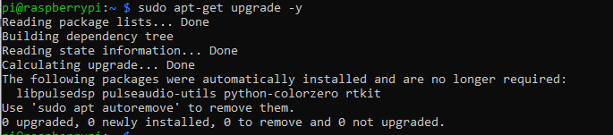
Interfacing

Slide 21
Interfacing
STEP 3: Installing omxplayer
In order to do that following command should be given inside terminal window $sudo apt-get install omxplayer

Slide 22
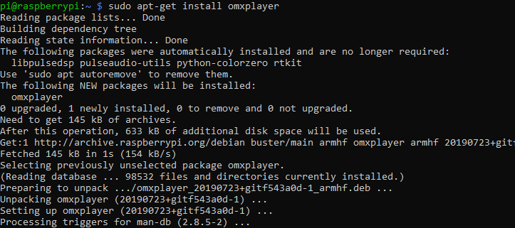
Interfacing

Slide 23
Interfacing
STEP4: Download a audio file
In this step we will download an audio file that will be played through the speaker and as the study suggested it’s better if the file is jazz or classical music

Slide 24
Interfacing
STEP 5: Playing the audio file
In order to play the audio file through aux port following command is required $omxplayer -o local <file destination>/<filename>.mp3 . This command will force the audio output through aux port

Slide 25

Interfacing

Slide 26
Interfacing
Speed and volume can be controlled by clicking following buttons on keyboard
to increase volume
to decrease volume
1 to increase speed
2 to decrease speed

Slide 27
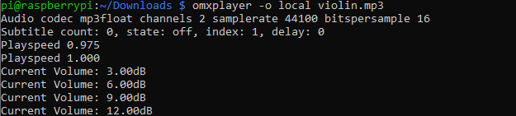
Interfacing

Slide 28
Interfacing
Additional Info:
By using the command $omxplayer -o hdmi <file destination>/<filename>.mp3 audio output can be pushed to HDMI port and by using command $omxplayer -o both <file destination>/<filename>.mp3 audio output will be pushed to both HDMI and AUX port

Slide 29
Interfacing
Additional info:
Omxplayer will close immediately if run in the background without user input, so to run successfully, you need to tell omxplayer not to require any user input using the --no-keys option
$ omxplayer --no-keys <filename>.mp3 &
Adding the & at the end of the command runs the job in the background. You can then check the status of this background job using the jobs command. By default, the job will complete when omxplayer finishes playing, but if necessary, you can stop it at any point using the kill command.

Slide 30
References
Nursery, P. (2020, February 20). Should You Sing to Your Plants? Here’s What the Science Says. Pistils Nursery. https://pistilsnursery.com/blogs/journal/music-and-plant-growth-heres-what-the-science-say
Audio configuration - Raspberry Pi Documentation. (n.d.). Unknown. Retrieved July 8, 2021, from https://www.raspberrypi.org/documentation/configuration/audio-config.md
9 Health Benefits of Music | NorthShore. (n.d.). Unknown. Retrieved July 8, 2021, from https://www.northshore.org/healthy-you/9-health-benefits-of-music/

Slide 31
References
Playing audio on the Raspberry Pi - Raspberry Pi Documentation. (n.d.). Unknown. Retrieved July 8, 2021, from https://www.raspberrypi.org/documentation/usage/audio/README.md
omxplayer – Raspberry Pi Projects. (n.d.). Unknown. Retrieved July 8, 2021, from https://raspberry-projects.com/pi/software_utilities/media-players/omxplayer
Omxplayer - eLinux.org. (n.d.). Unknown. Retrieved July 8, 2021, from https://elinux.org/Omxplayer

Slide 32
THANK-YOU

